Slide 1
sunhaotai
Jilin University

Slide 2
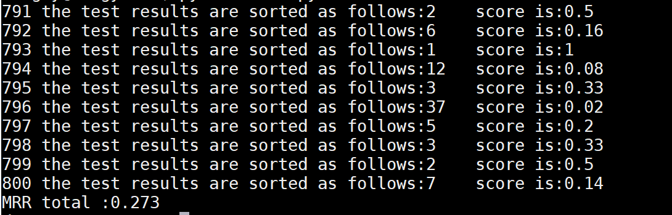
MRR
MRR test
train quantity：4546
Test quantity：800
MRR（1）=0.273 MRR（5）=0.316 MRR（10）=0.379

Slide 3
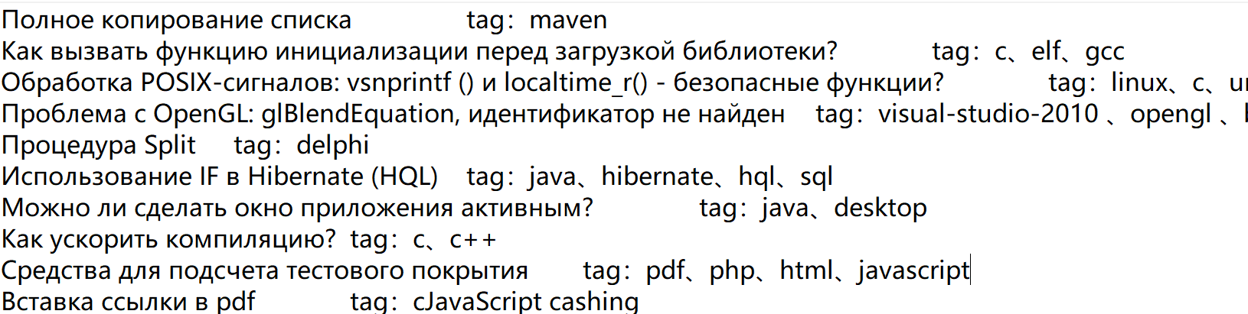
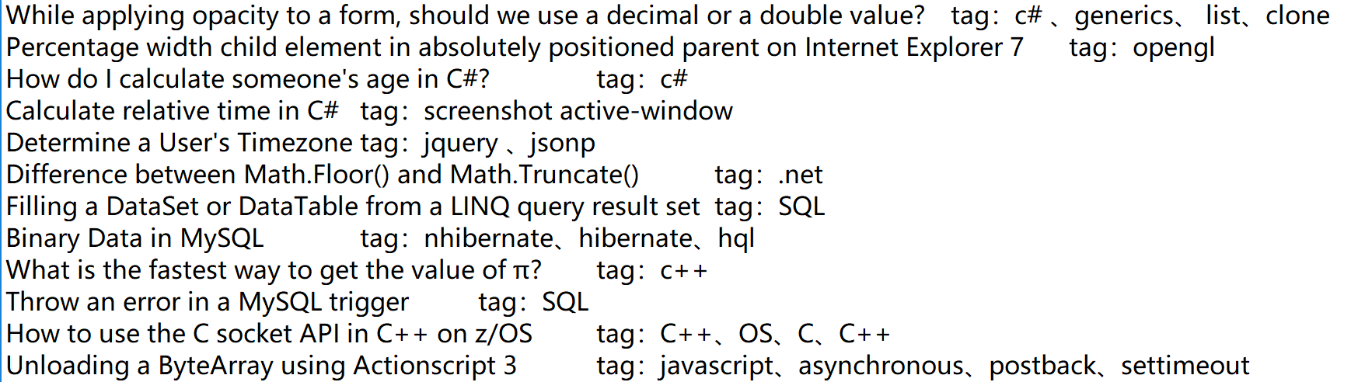
Tag correspondence analysis
data processing
problem：
answer：
Notes:
1.MRR(1.5.10)
2.LUCENE

Slide 4
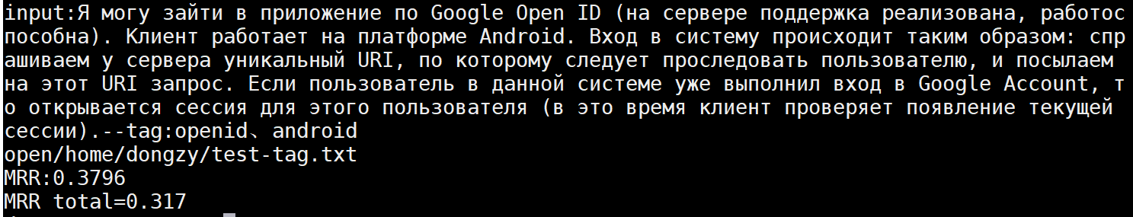
Tag correspondence analysis
Test quantity：196
MRR=0.317 MRR（5）= 0.395 MRR（10）=0.492
Example

Slide 5
Lucene
（1）test
Test quantity：800
Example
Russian ：Как отобразить маршрут на карте Google в приложении Android?
English：how to display the route on the map in the annex google android?
Result ：
Enter query: lucene
Searching for: how to display the route on the map in the annex google android?
357 total matching
1. Map Routing, a la Google Maps?
2. Has anybody used Google Performance Tools?
3. Options for Google Maps over SSL
4. Simplest way to make a Google Map mashup?
5. Google Maps API - Problems with class GLatLngBounds
6. Best way to fix CSS/JS drop-down in IE7 when page includes Google Map
（2）MRR=0.346 MRR（5）= 0.389 MRR（10）=0.489

